Slide 1

Amritsar College of Engineering & Technology, Amritsar, Punjab, INDIA NAAC - A grade, NBA accredited courses(2009-12, 2016-18), UGC Autonomous College
SUBJECT: OOPS (ACCS-16302)
UNIT-I
Er. Neha Chadha
Assistant Professor
Department of Computer Science and Engineering

Slide 2
Content
History of C++
Introduction to C++
Application areas of C++
Difference between POP and OOP
Difference between C and C++
Features of C++
Basic Concepts of OOPS

Slide 3
History of C++
C Front
C Pre
C with Classes
C++
C++ was initially known as “C with classes, ” and was renamed C++ in 1983. ++ is shorthand for adding one to variety in programming; therefore C++ roughly means that “one higher than C.”

Slide 4
Developer: Bjarne Stroustrup
Name suggested : Rrick Mascitti

Slide 5
Introduction to C++
C++ is a general purpose, high level , compiler based and object oriented programming language.
General Purpose: Different types of software
OS
Editors
Commercial Applications
Database
Translators
Device drivers
Games
Protocols

Slide 6
Applications areas of C++
User interface design such as windows, menu.
Real Time Systems.
Simulation and Modeling.
Object oriented databases.
AI and Expert System.
Neural Networks and parallel programming.
Decision support and office automation systems etc.

Slide 7
Difference between POP and OOP
Parameters | OOP | POP
Basic Definition | OOP is object-oriented. | POP is structure or procedure-oriented.
Program Division | The program is divided into objects. | The program is divided into functions.
Approach | Bottom-Up approach | Top-down approach
Data Control | Data in each object is controlled on its own. | Every function has different data, so there’s no control over it.
Entity Linkage | Object functions are linked through message passing. | Parts of a program are linked through parameter passing.
Expansion | Adding new data and functions is easy. | Expanding data and function is not easy.
Inheritance | Inheritance is supported in three modes: public, private & protected. | Inheritance is not supported.

Slide 8
Parameters | OOP | POP
Access control | Access control is done with access modifiers. | No access modifiers supported.
Data Hiding | Data can be hidden using Encapsulation. | No data hiding. Data is accessible globally.
Overloading or Polymorphism | Overloading functions, constructors, and operators are done. | Overloading is not possible.
Friend function | Classes or functions can be linked using the keyword “friend, only in C++. | No friend function.
Virtual classes or functions | The virtual function appears during inheritance. | No virtual classes or functions.
Code Reusability | The existing code can be reused. | No code reusability.

Slide 9
Difference between C and C++
S.No | C | C++
1 | It is structure or procedure oriented programming language | It is object oriented programming language
2 | It follows top down approach | It follows bottom up approach
3 | Polymorphism,Inheritance and Data encapsulation are not possible in C | Polymorphism,Inheritance and Data encapsulation are possible in C++
4 | No data security | Data security is possible
5 | Data abstraction i.e. data hiding is not possible in C | Data abstraction i.e. data hiding is possible in C++
6 | Function overloading and operator overloading is not possible in C | Function overloading and operator overloading is possible in C++
7 | Generic Functions are not possible in C | Generic Functions are possible in C++
8 | In C,Calloc() and Malloc() functions are used for memory allocation and free() function for memory deallocation | In C++,new and delete operators are used for memory allocation and deallocation
9 | In C,file extension is .c | In C++,file extension is .cpp

Slide 10
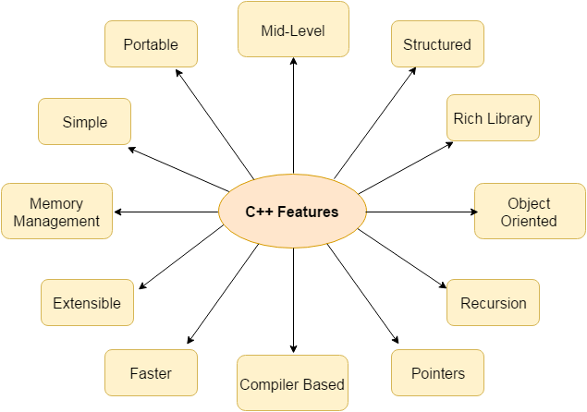
Features of C++

